Slide 1
Railway Oriented Programming
(Monadic Error Handling) To Err is Human; To Forgive Divine
Notes:
The goal of this talk is to have a more deterministic control flow. How do we fail gracefully.

Slide 2
Agenda
What is ROP
Why use ROP
What is a monad?
Create ROP Module
Apply it to Rest API (if time)

Slide 3
What is ROP?
Programming style to handle errors in a functional way.
All of this stolen from Scott W.
He has 2 videos and several blog posts
http://fsharpforfunandprofit.com/
Notes:
The goal of this presentation is to get you to go to his blog!

Slide 4
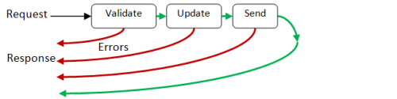
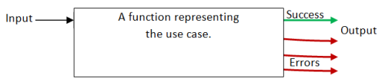
What is ROP?
Non Functional
Returns early through null checks and exceptions
Functional
Build a single function that returns strongly typed response of either a success or error.
Notes:
Non Funtional: bad because the compiler does not force you to handle it.

Slide 5

Try Not!
Do or Do Not.
There is no
Try{}
Catch{}
Notes:
Golden Rule

Slide 6
Why ROP?
More Predictable
More Testable
More Documentable
More Reasonable
Notes:
Hopefully by the end of this you will agree…

Slide 7

Watch Your language
Notes:
Dirty Words:
Monoid
Monad

Slide 8
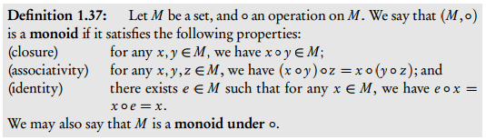
MONOIDS
Notes:
This is why people hate the word monoid Disclaimer: This is set theory. Really we are talking about category theory, but this is easier to understand.

Slide 9
Monoids in real life
Set and operation
If I combine two things I get the same thing
I can perform combinations in any order and get the same result
There is something that when combined with anything gives me the same thing
Notes:
Anyone think of a Monoid?

Slide 10
Monoids in real life
Integers and Addition
If I “ADD” two “INTEGERS” I get another “INTEGER”
(X + Y) + Z = X + (Y + Z)
X + 0 = X
Notes:
Also concatenating strings, concatenating lists, multiplication, maximum
Can anyone think of an operation that is not a Monoid? Subtraction, division, list subtraction,

Slide 11
MONADS

Slide 12
MoNADS in real life
Monad Type and operation
If I combine two functions ‘a→ m ‘b and ‘b→ m ‘c I get ‘a→ m ‘c
I can perform combinations in any order and get the same result
There is something that when combined with anything gives me the same thing
Notes:
Disclaimer: this is also way two specific but don’t worry about it.

Slide 13
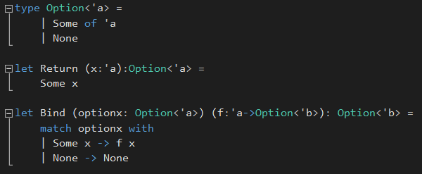
Option Monad

Slide 14
Option MoNAD in real life
A’ → Option A’ and Bind (>>=)
If I “Bind” two “functions into option” I get another “function into option”
These are the same: a’ → option ‘d
(‘a→ option ‘b =>> ‘b→ option ‘c ) =>> ‘c→ option ‘d
‘a→ option ‘b =>> (‘b→ option ‘c =>> ‘c→ option ‘d )
Bind(Return ‘a) = option ‘a → option ‘a

Slide 15
Let’s begin!
For ROP we need:
Something that will allow us to wrap our output into strongly typed ‘Result’ that can be either a success or a failure
Something that will allow us to combine our functions that return this ‘Result’ type
Something that allow to take any value and create this new result type
Notes:
I’ll give you one guess what we are going to use?

Slide 16


Our Monadic Type: two Track Result
Switch Function
Notes:
This is why the term Railway Oriented Programming.

Slide 17
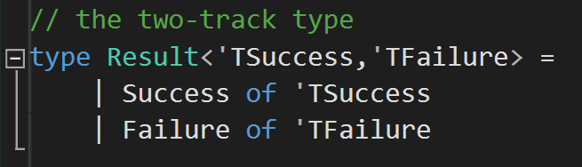
Our Monadic Type: Two Track Result

Slide 18
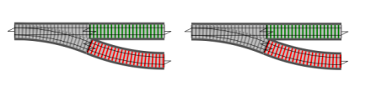

Our Bind: building on the Railroad

Slide 19
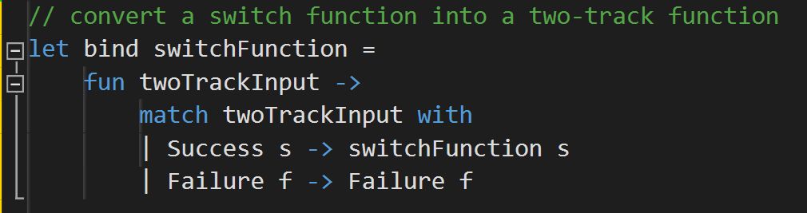

Our Bind: building on the Railroad

Slide 20

Our Bind: building on the Railroad
Notes:
We can see our Railroad begin to work

Slide 21
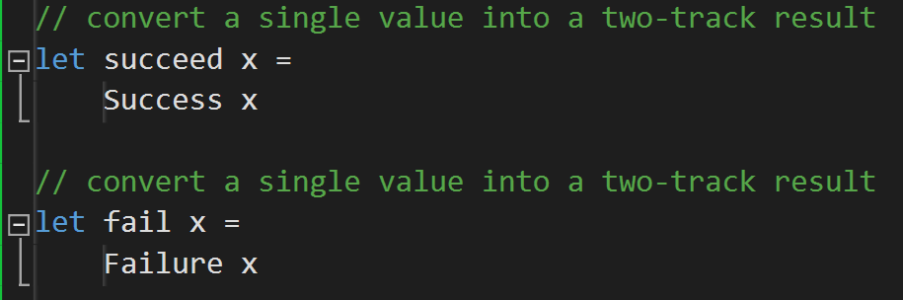
Our Identity: succeed and Fail

Slide 22
Lets play around
First Code sample

Slide 23
You now know 80% of ROP and 2% of Monads Lets make this more Robust
Congratulations!!!

Slide 24
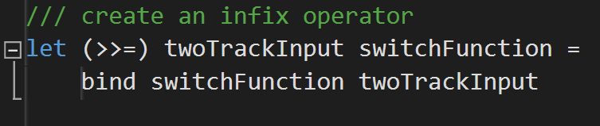
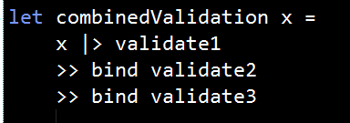
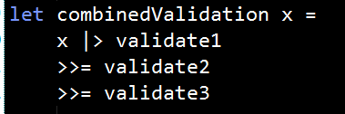
Infix Operator

Slide 25
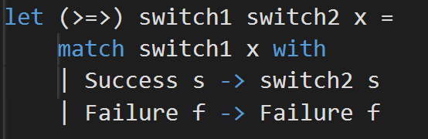
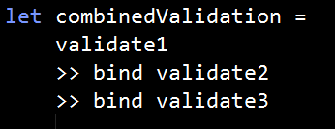
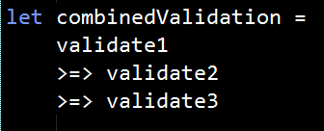
Composition

Slide 26
Bind vs. switch composition
Bind has one switch function parameter. It is an adapter that converts the switch function into a fully two-track function (with two-track input and two-track output).
Switch composition has two switch function parameters. It combines them in series to make another switch function.
Notes:
We have two different concepts that at first glance seem quite similar. What's the difference?

Slide 27
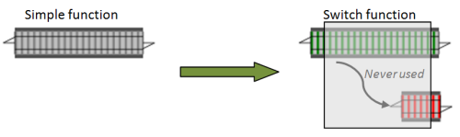
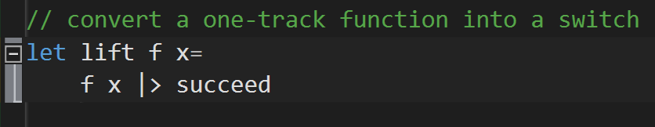
Lift: Handling One Track Functions
Notes:
What do we do for functions that don’t throw errors?

Slide 28
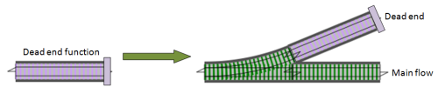
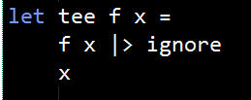
Tee: Handling One Track Functions

Slide 29
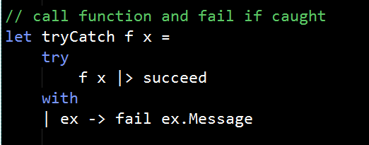
trycatch: Handling exceptions

Slide 30
Lets play around
second Code sample

Slide 31
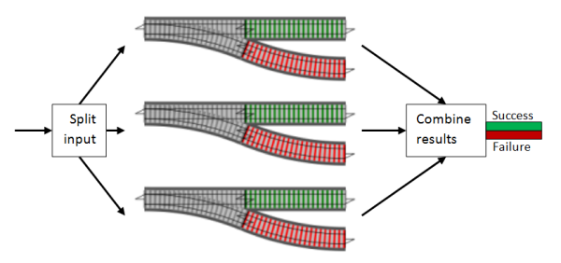
What if I want to do these in parallel?
Notes:
Works great if your

Slide 32
What if I want to do these in parallel?
Works best if you have monoids for your result types ‘TSuccess ‘Tfailure
You can usually massage a non-monoid into a monoid

Slide 33
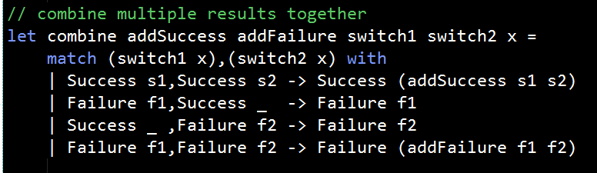
Combine: Add together multiple results

Slide 34
Creating a monoid
Closure
Replace single items with a list
You can also use some sort of key value storage if you need named reference

Slide 35
Creating a monoid
Associativity
To get associativity for an operation, try to move the operation into the object.
2-3-4 => 2 + -3 + -4
5/3/6 => 5 * 1/3 * 1/6
This can be complicated depending on the operation, but usually possible to do.

Slide 36
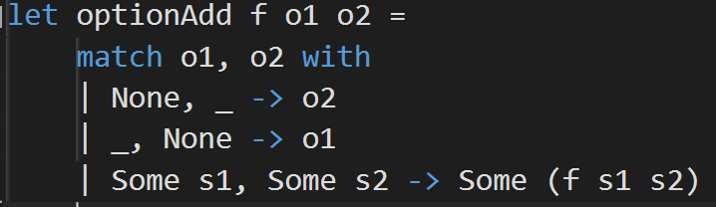
Creating a monoid
Identity
Trivial
If it doesn’t exist you can just make it up
To get identity for an operation, create a special case in a discriminated union, or, even simpler, just use Option.

Slide 37
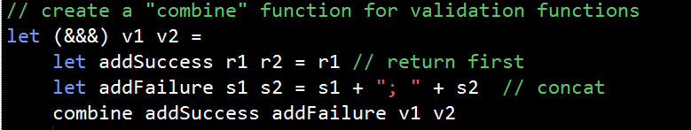
Combine: Add together multiple results

Slide 38
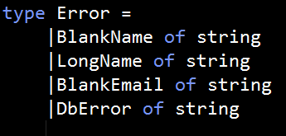
Strong Error Types
You want to use DUs instead of strings for your error messages

Slide 39
Lets play around
Third Code sample

Slide 40
Thank You
Dominick Aleardi
Software Engineer @ Quicken Loans
Daleardi@Gmail.com

Slide 41
Other Topics
Injecting functions into flow based on application inputs/configuration
Adding Warning Messages to your success type
Adding Warning Type: Three track model
Doing this asynchronously
Creating Computation Expression to do this
Read Scott W.’s blog!

